Slide 1


CH Banking Solutions
Caroline de Sa Teixeira & Heber Junior dos Anjos Mota
A Project For Fraud Detection Using Machine Learning

Slide 2
Outline
Business Understanding
Data Understanding
Data Preparation
Modelling
Evaluation
Deployment
Code

Slide 3
Business Understanding
Objective:
Detect and prevent frauds.
Approach:
Leverage dataset properties for fraud detection.
Visualization, encoding.
Value:
Empower clients with behavioural insights.
Facilitate trend identification for business operations.
Future:
Develop competitive initial product.
Focus on continual improvement and innovation.

Slide 4
Data Understanding
Content:
Curated by Petr Berka and Marta Sochorova.
Financial data from a Czech bank.
Details of 5,300 bank clients.
Approximately 1,000,000 transactions.
Close to 900 credit cards provided.

Slide 5
Data Preparation
Decisions:
Excluded datasets and features.
Converted dates, language and currency.
Gender and age from date of birth.
Replaced missing data.
Merged the datasets together.
Normalization Process:
Standard Scaler for numerical values.
One-Hot Encoding for categorical values.

Slide 6
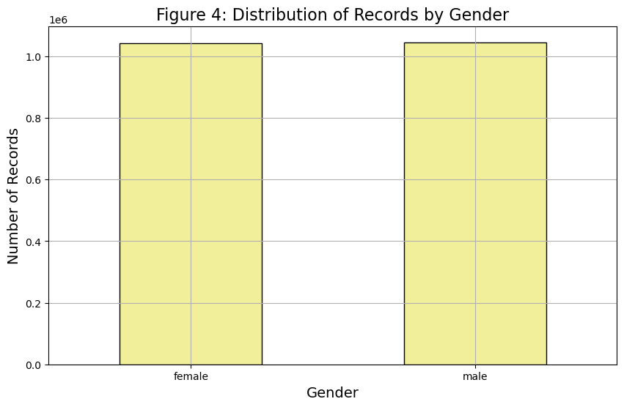
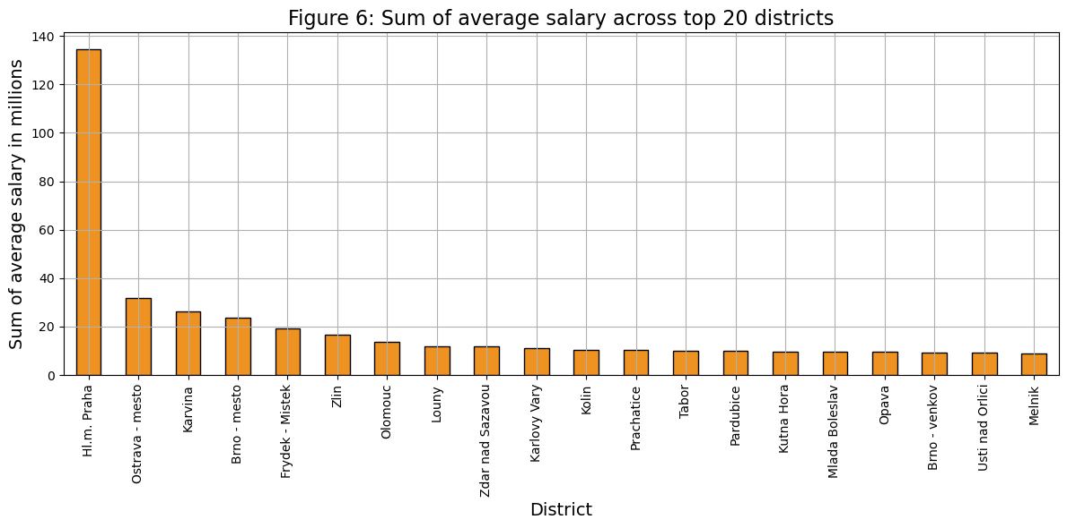
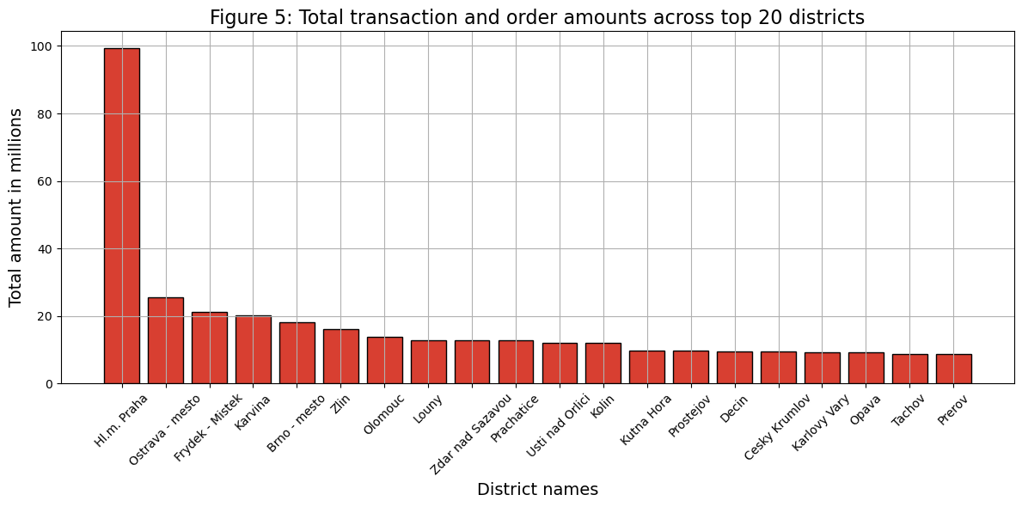
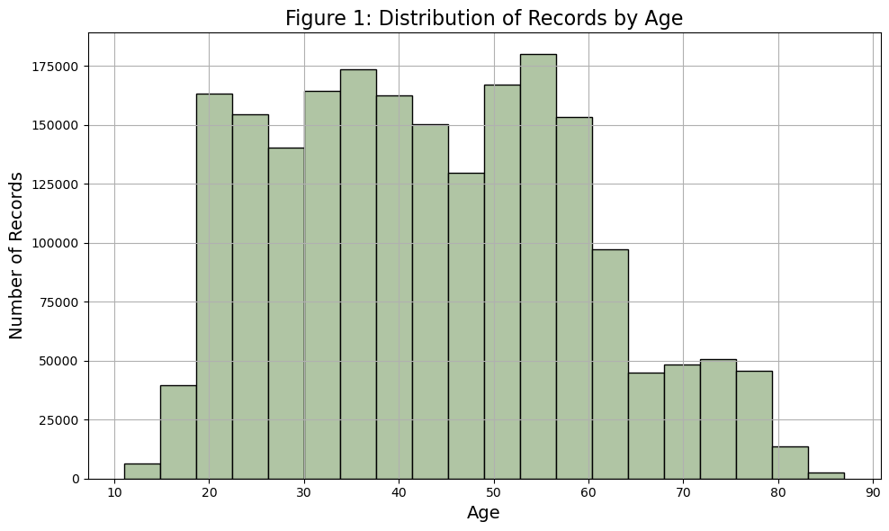
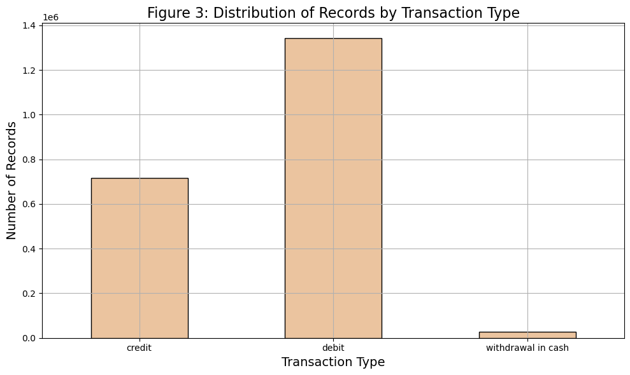
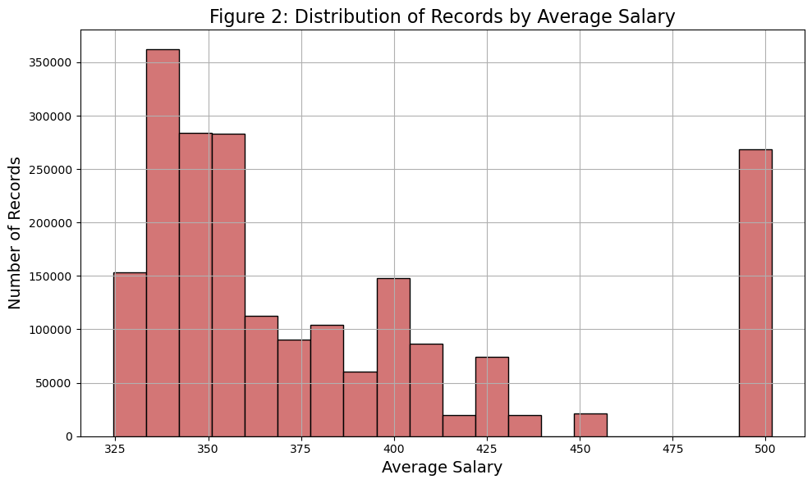

Slide 7
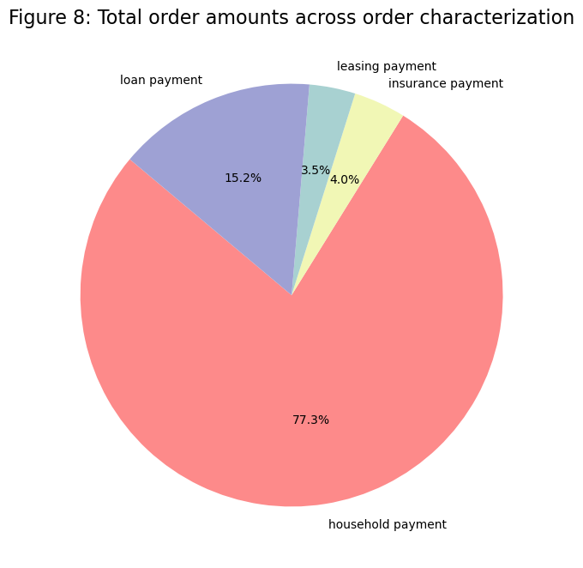
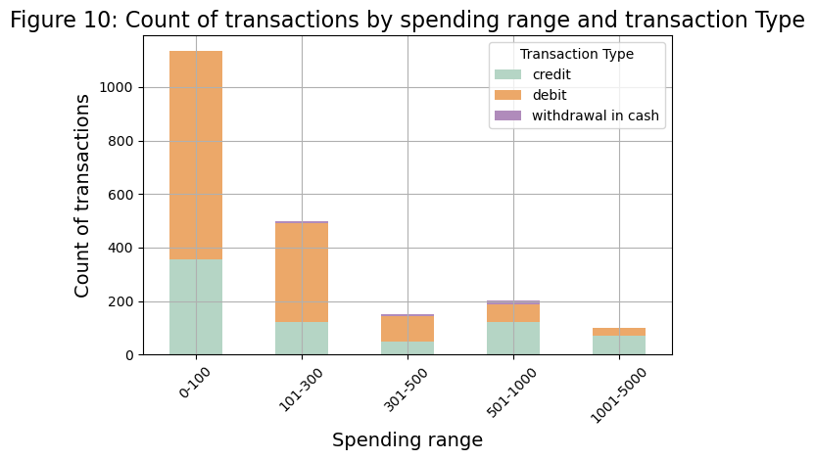
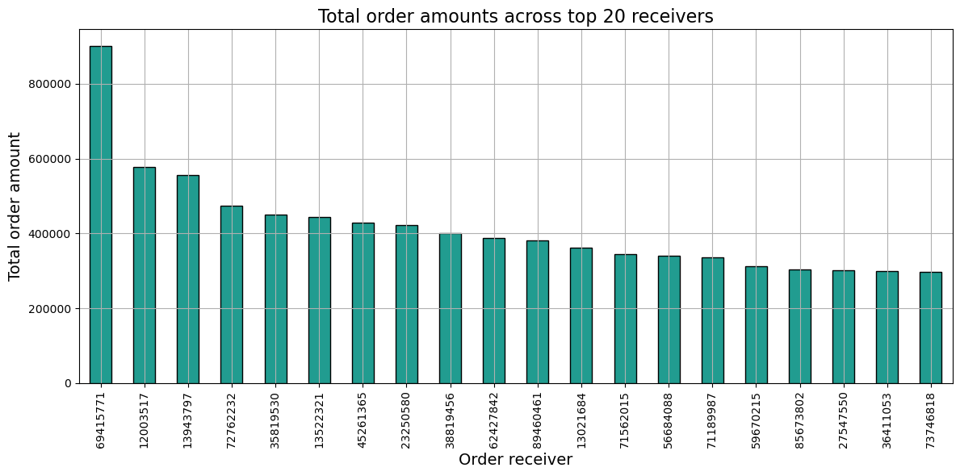
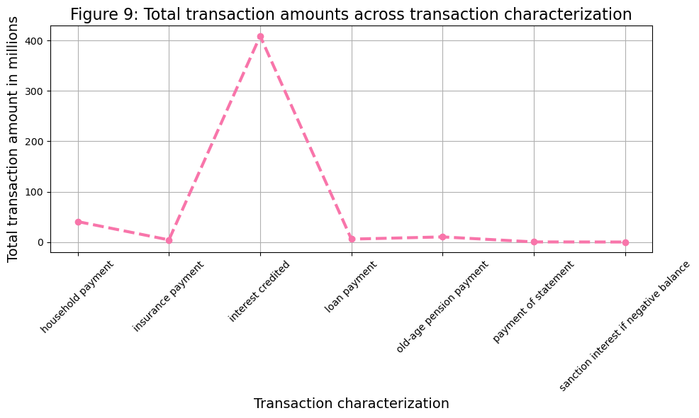
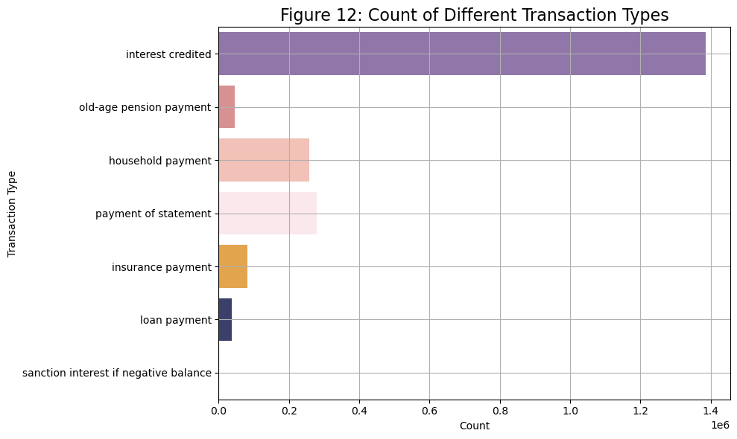
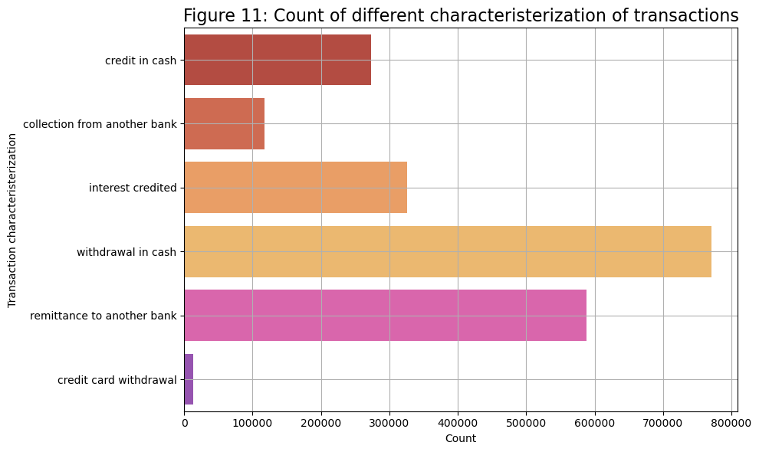

Slide 8
Modelling
RF, DT & LR:
RF: Captures complex relationships.
DT: Captures straightforward rules.
LR: Interpretable, suitable for binary tasks.
Ensemble:
Stacking combines multiple models' predictions.
Bagging trains models on varied data subsets.
Boosting iteratively corrects errors.

Slide 9
Evaluation
Stacking Classifier: Accuracy - 0.8915
Bagging Classifier: Accuracy - 0.8930
Boosting Classifier: Accuracy - 0.8931
Total instances of fraud: 2,837 (0.07%).
Non-fraudulent cases: 414,736 (99.3%).
With an accuracy of 89.31%, Adaboost demonstrates the best accuracy

Slide 10
Deployment
Initially planned AWS Cloud Services and JavaScript.
Shifted focus to developing highly efficient model.
Final csv files and models available as resources at the end of the project.

Slide 11
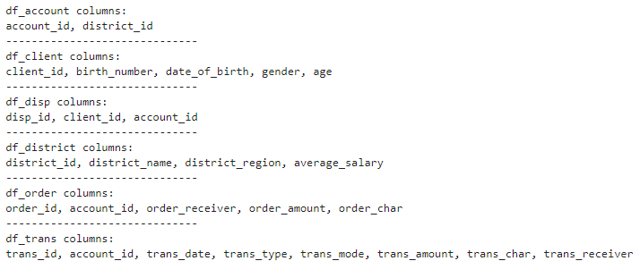
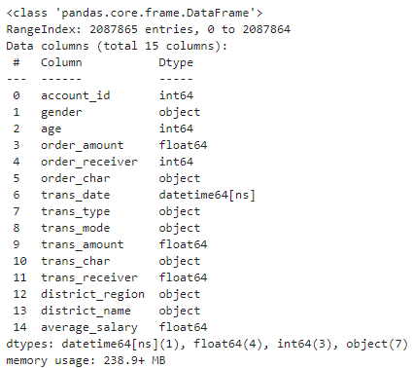


Slide 12
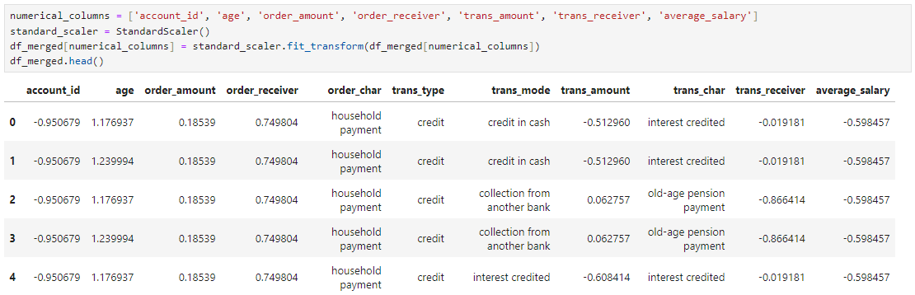
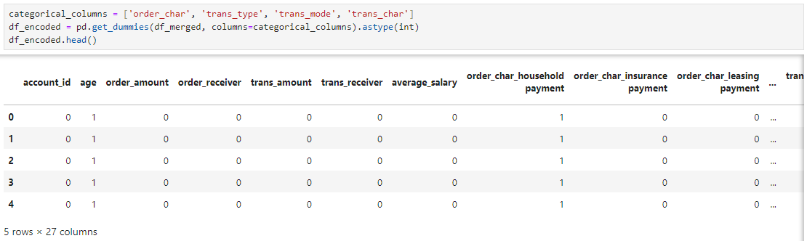
Merged dataset, new and renamed columns

Slide 13
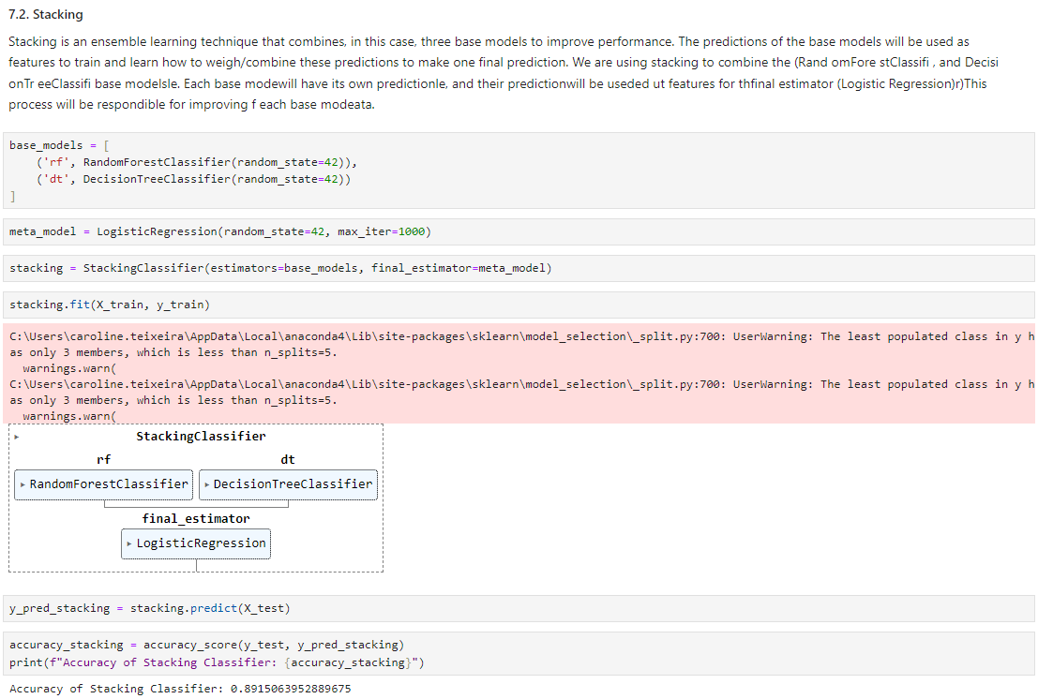
Merged dataset, new and renamed columns

Slide 14
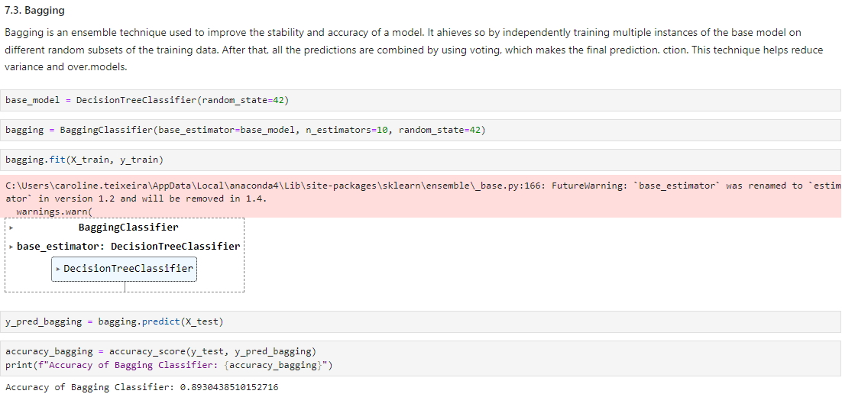

Slide 15
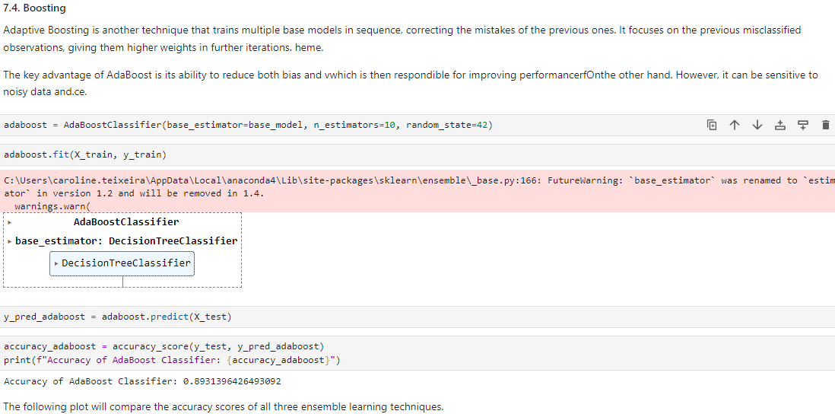

Slide 16
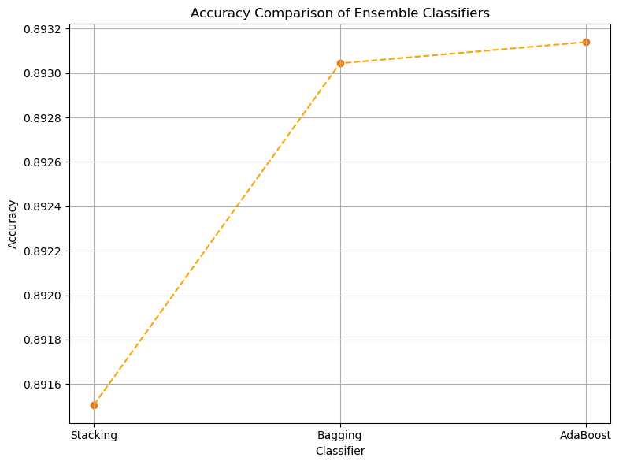
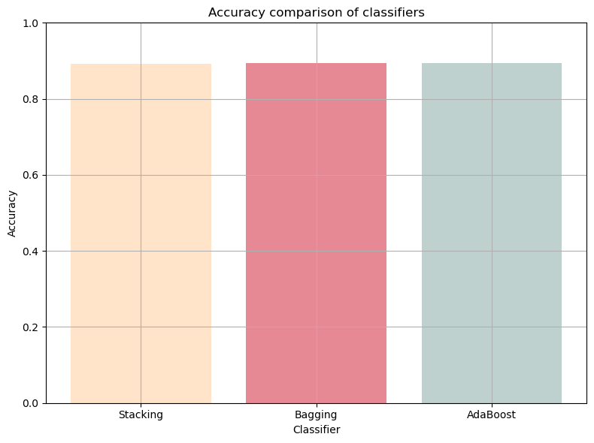

Slide 17
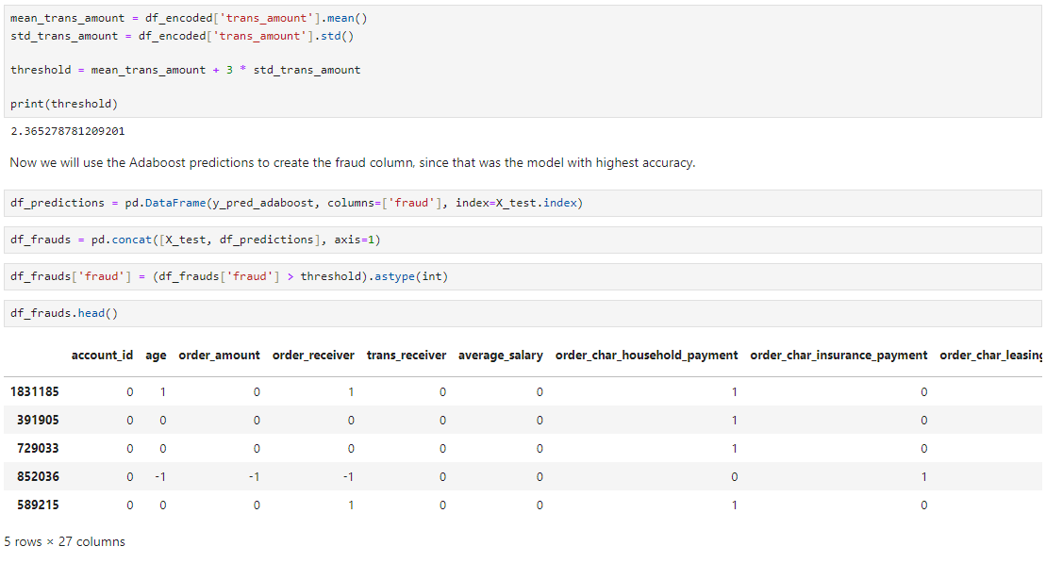
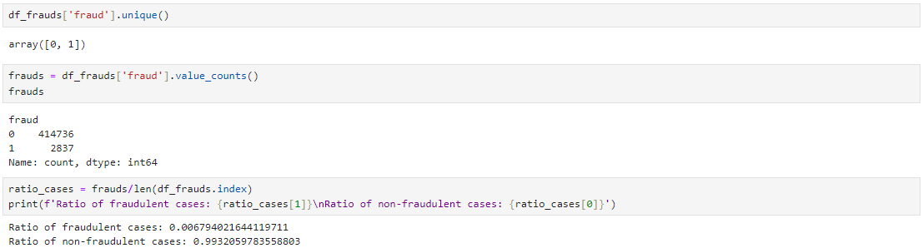

Slide 18
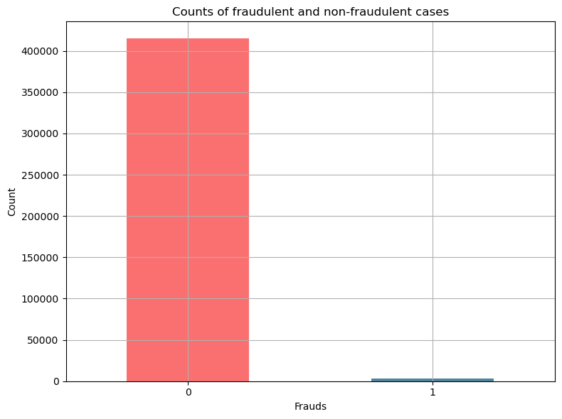

Slide 19

Thank you for your time & attention.
Any questions?

